Slide 2
Indexing 3D Scenes Using the Interaction Bisector Surface
Xi Zhao
He Wang
Taku Komura
University of Edinburgh

Slide 3
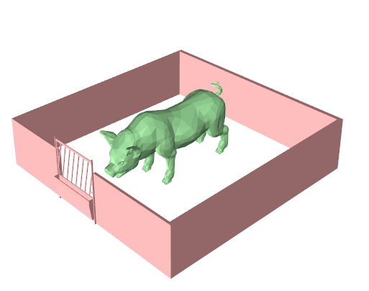
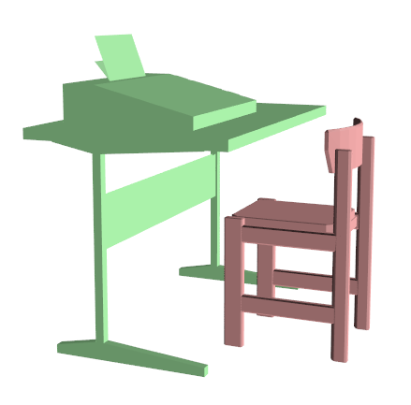
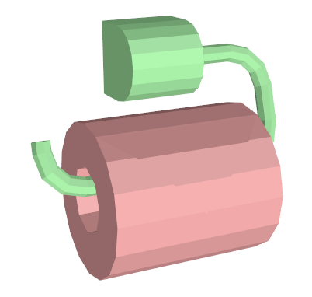
How do we describe the spatial relationships between these pairs of objects?
“surround” “tucked under” “hook on”
Notes:
In this paper, we address the problem of describing spatial relationships between objects in 3D scenes.
Here are three example scenes.
It is quite easy for us to recognize the relationships between these pair of objects: a pig surrounded by fence,
a chair tucked under the table and a toilet paper hooked on the handle.

Slide 4
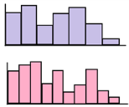
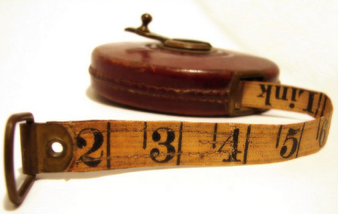
How can we quantify these spatial relationships?
“surround”
?
“tuck under”
“hook on”
Notes:
How can we quantify such relationships in order to make the computer recognize them?
To do this, an effective representation of spatial relationship is needed

Slide 5
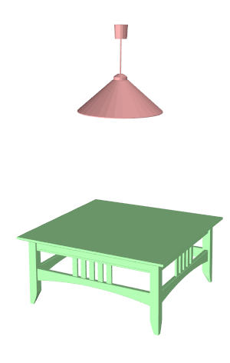
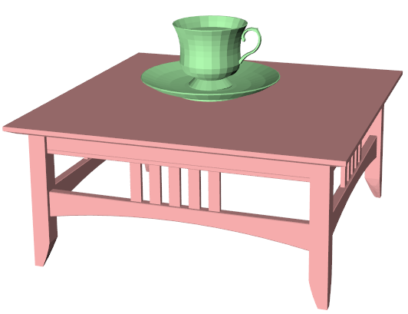
Previous Representations of Spatial Relationships
d
Contact
[Fisher et al. 2011]
2. Distance [Fisher et al. 2010]
3. Relative direction
[Fisher et al. 2010]
Notes:
Here I list some commonly used representations of spatial relationships in the previous work:
The first one is the contact information, in this example, the cup and the table are in contact with each other.
We can easily find which part of the objects are in contact by checking the distance between each pair of the polygons from the object meshes.
The second one is the distance information. Normally the centre of object’s bounding box is computed and the
distance between the centres are used to represent the distance between the objects.
The third feature is the direction descriptor. One way to compute it is to find the vector from scene centres to the objects’ centres,
and use the angle between these vectors to represent the relative direction between the two objects.
These representations are easy to compute and are proven to be useful, but their power to describe the relationships is limited.
Next, I will use a example to explain why these simple representation are not enough.

Slide 6
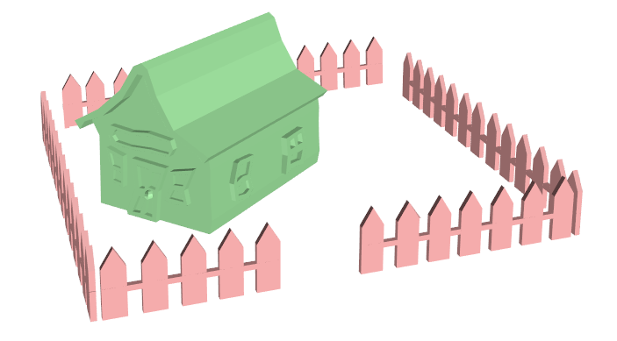
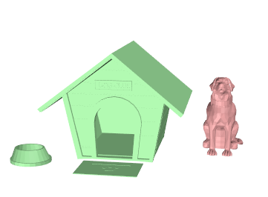
Limitation of Previous Presentations
Distances between object centres for these two scenes are quite similar:
Notes:
Here we have two scenes,
The first one is the house is surrounded by a fence
The second one is a dog sitting beside a dog house
If we use the distance representation, it is difficult to tell the difference between these two relationships,
as the distances are almost the same.
//------------------------------
But if we compute the interaction bisector surfaces, their geometries are very different, and we can easily tell
the difference between these two spatial relationships..

Slide 7
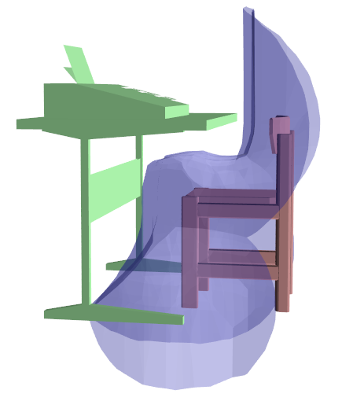
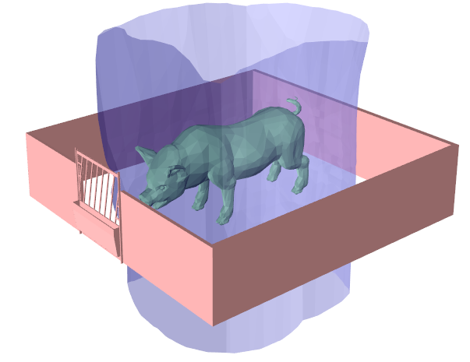
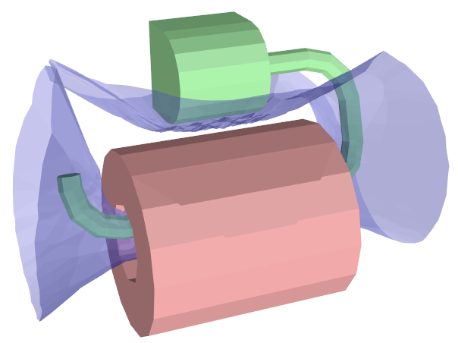
Objective
Quantify spatial relationships by
Interaction Bisector Surface (IBS)
Notes:
The first objective of our work is to find a good representation of spatial relationships.
We propose to use the Interaction Bisector Surface, which are these transparent blue surfaces in these images.
These surfaces are located between the pair of objects and equidistant to both objects.
//---------------------
The points of IBS have similar property as Medial axis points: they have more than one closest point from different object.
Similar to the medial axis, the IBS abstract the space between the objects.

Slide 8
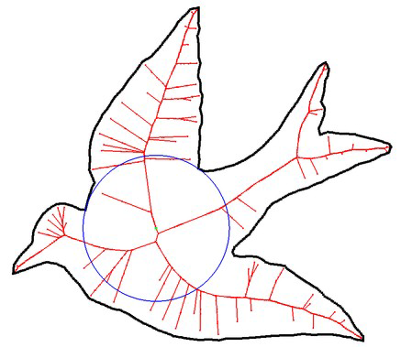
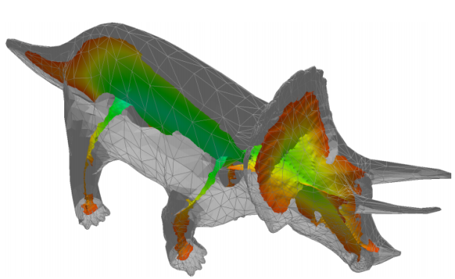
Medial Axis and IBS
Medial Axis
IBS
2D Medial Axis
[Shapiro. 2011]
3D Medial Axis
[Sud et al. 2004]
Notes:
The IBS is quite related to medial axis.
The medial axis of an shape is the set of all points having more than one closest point on the shape boundary.
It is an abstraction of the space within the shape boundary.
IBS is also a set of points with the same property as the medial axis.
It can also be considered as an abstraction of the space between the objects.

Slide 9
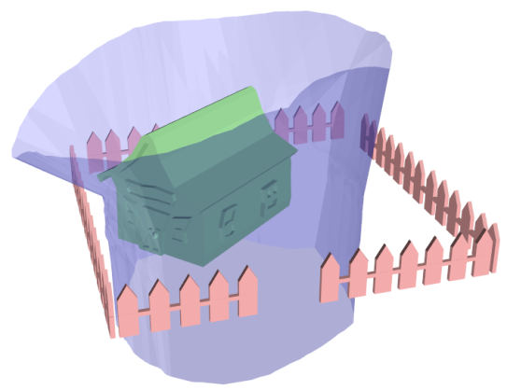
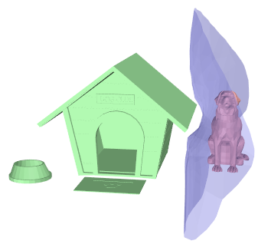
Previous Representation vs IBS
Distance between object centres:
Interaction Bisector Surface (IBS):
Notes:
The scenes that I described before, whose difference cannot be described well by the Euclidean distance, can be easily distinguished using the IBS as the topologies and geometries of the IBS will be very different.

Slide 10
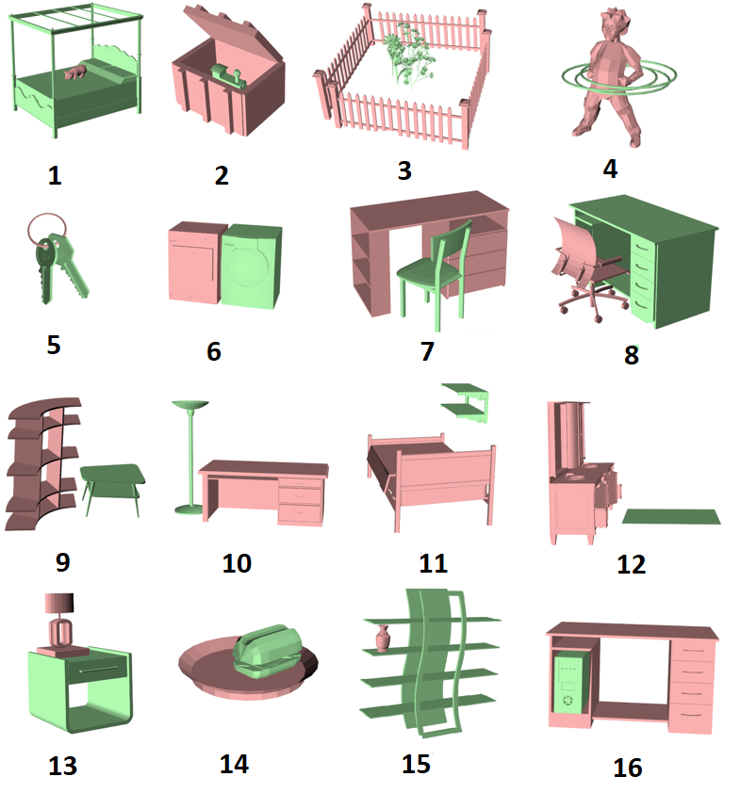
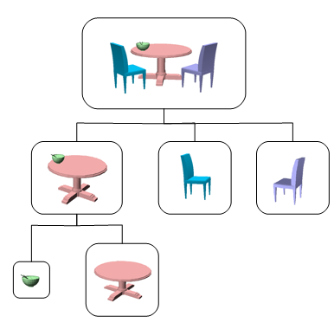
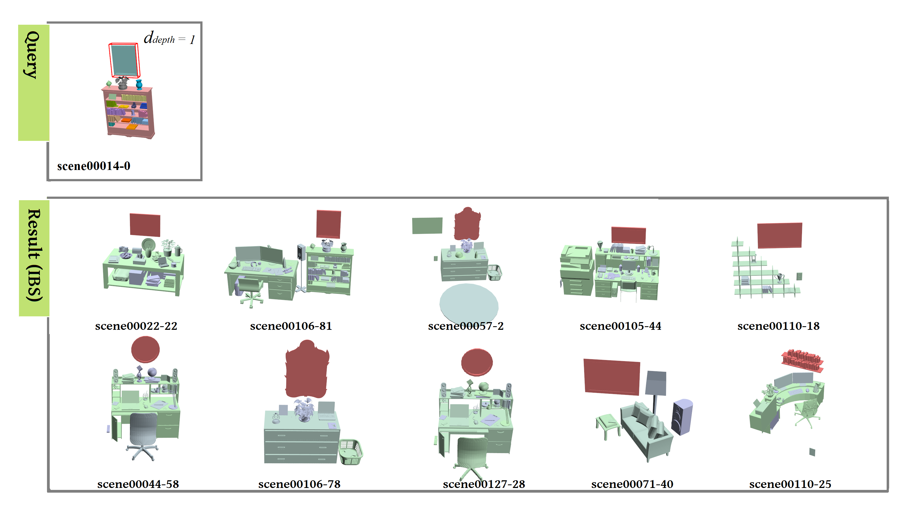
Objective
Apply our new representation IBS to 3D scenes analysis
Scene classification
Scene structure
construction
Retrieval
Notes:
Then we apply this representation for the classification of scenes with two objects,
scene structure construction, and the retrieval of single objects in big scenes

Slide 11
Overview
Basics of IBS
Computation
Features
Applications
Scene classification
Scene structure analysis
Spatial relationship based retrieval
Notes:
This is the overview of this talk.
I will first introduce the basics of IBS.
Then I will describe about using it for different applications.

Slide 12
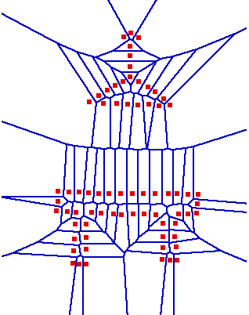
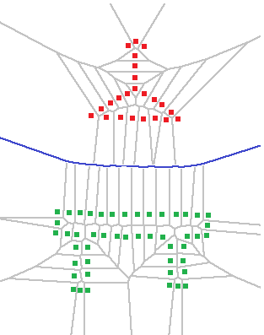
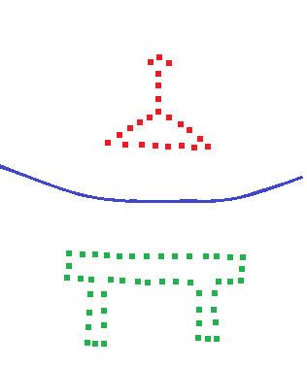
Computation of IBS
Input
Select Voronoi edges
between two parts
Voronoi Diagram
Resulting IBS
Notes:
To compute the IBS, we start from a point cloud, which is sampled from the input 3d objects. We know which point belongs to which object.
We then compute the Voronoi diagram for all these samples,
And next check each voronoi diagram elements. Here the elements are Voronoi edges.
If one Voroni edge is produced by input samples that belong to different objects, we keep it. All this type of edges form the IBS.
In 3D, the voronoi diagram elements are polygons, so the resulting IBS is a polygon mesh.

Slide 13
IBS Between Two Objects
Notes:
Here are some example IBS of different scenes.

Slide 14
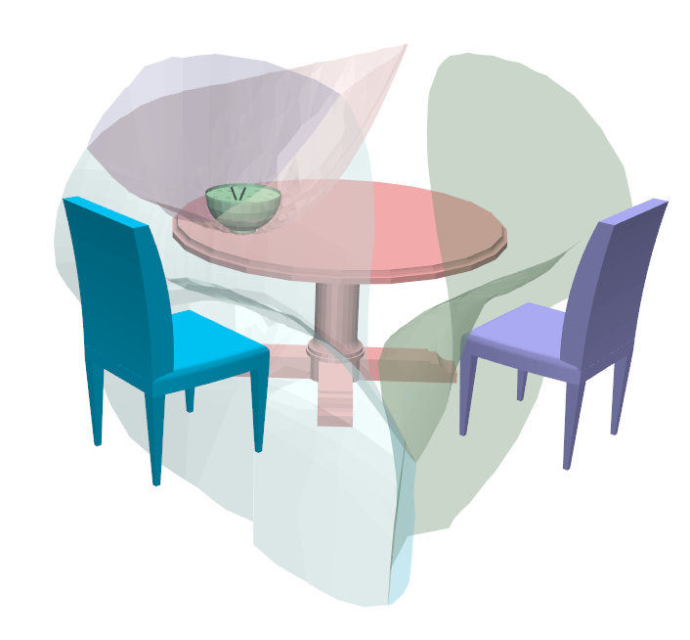
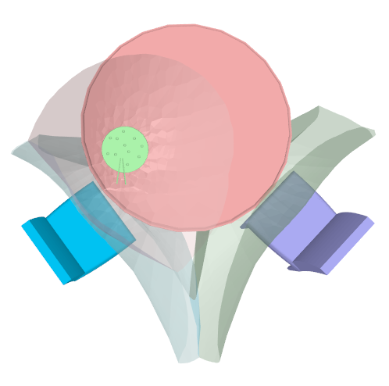
IBS Between Multiple Objects
Notes:
Here is the IBS for a scene with more objects.
Each region of the IBS corresponds to different pairs of objects

Slide 15
IBS Features
Features of IBS which are useful for scene analysis:
Topological features (Betti numbers)
Geometric features (distance, direction, PFH)
Notes:
Now we describe about the topological and geometric features of the IBS, that is useful for analyzing the
spatial relationships of the objects in the scene.

Slide 16
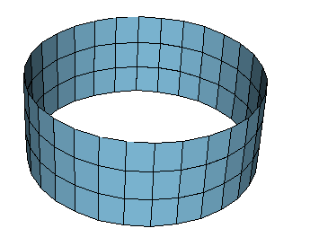
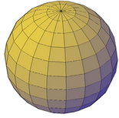
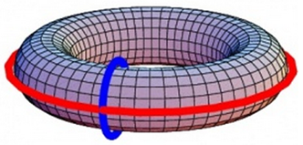
Topological Features: Betti Numbers
b1: number of loops
b2: number of closed surfaces
b1 = 1
b2 = 0
b1 = 0
b2 = 1
b1 = 2
b2 = 1
Notes:
We use the Betti numbers to capture the topological feature of the IBS.
Here b1 represents the number of independent circuits (is this more clear?).
B2 is the number of closed regions within the shape.

Slide 17
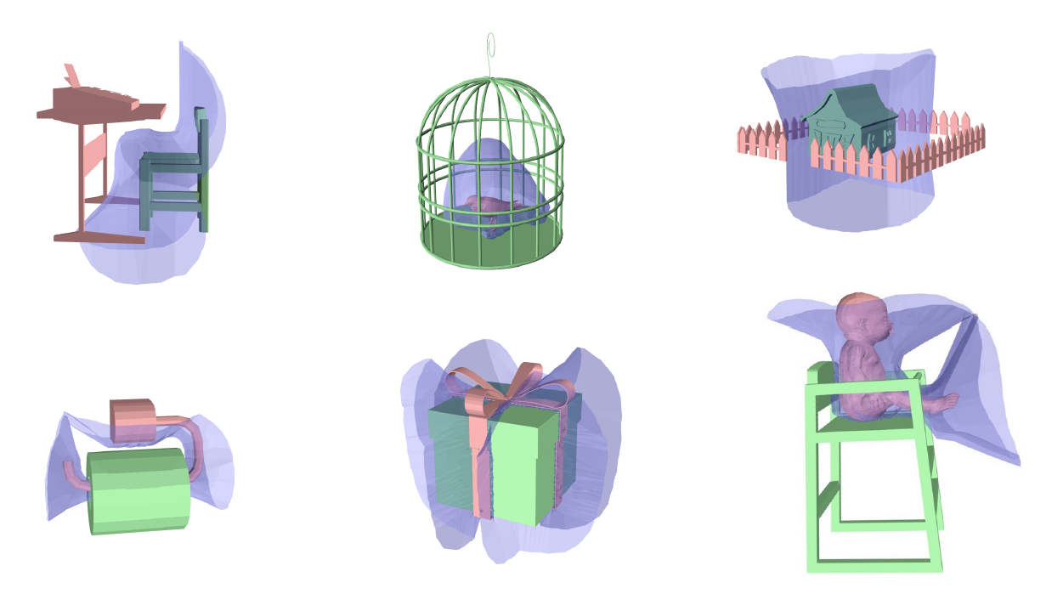
Topological Features
b1 = 1
b2 = 0
b1 = 0
b2 = 0
b1 = 0
b2 = 1
b1 = 2
b2 = 0
b1 = 3
b2 = 0
b1 = 4
b2 = 0
Notes:
Different types of spatial relationships can produce IBS with different topology.
For spatial relationships like besides, surround, and encircle normally produce IBS shape which has the same topology as a plane, sphere and cylinder respectively.
For more complex spatial relationships which containing tangling or wrapping, the IBS shape normally contains more handles and tunnels, which produce a larger b1 number.
(It is better to describe one by one, depends on the time)

Slide 18
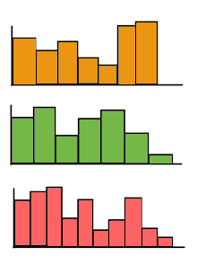
Geometric Features
dir
dis
Distance
PFH*
Direction
Shape
*PFH: Point Feature Histogram [Rusu et al. 2008]
Notes:
So the topological features only provide abstract information of the spatial relationship, to further encode the detailed information, we also examine the geometry of the IBS.
For each point of the IBS, (click), for example, this yellow point, we compute (click) distance from the IBS to object,
(click) the direction of the normal vector of the IBS polygon, and (click) the PFH feature for the current point on the IBS.
PFH is a histogram of the relative rotation between the normal vectors of each pairs of points.
(click) We then put all the features for each IBS elements together to build histograms, and use them as features
which describe the distance information, direction information and global shape of the IBS.
18

Slide 19
Overview
Basics of IBS
Computation
Features
Applications
Scene classification
Scene structure analysis
Spatial relationship based retrieval
Notes:
Next I will explain three applications where the IBS can be effectively used.

Slide 20
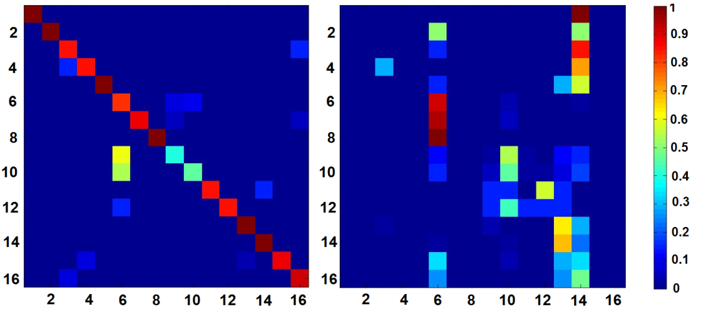
Classification
Database
Resulting confusion matrix
Our method
Previous method
Notes:
The first application is the classification of 3D scenes.
We use a database of scenes with two objects. These scenes are manually divided into 16 different classes and labelled.
Here we trained a scene classifier that make use of the topological and geometric features of the IBS.
(Describe how it is trained)
We compare the results with features used in previous research: the distance and relative direction of object centres.
Here are the resulting confusion matrices.
They show that the previous simple representations misclassify most of the classes, while the IBS based features give a better result. A high diagonal values in the left figure show that most of the test examples are classified correctly by using IBS based features.
20

Slide 21
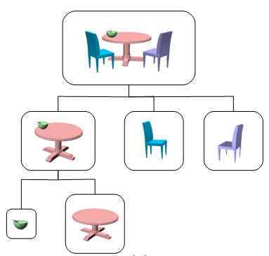
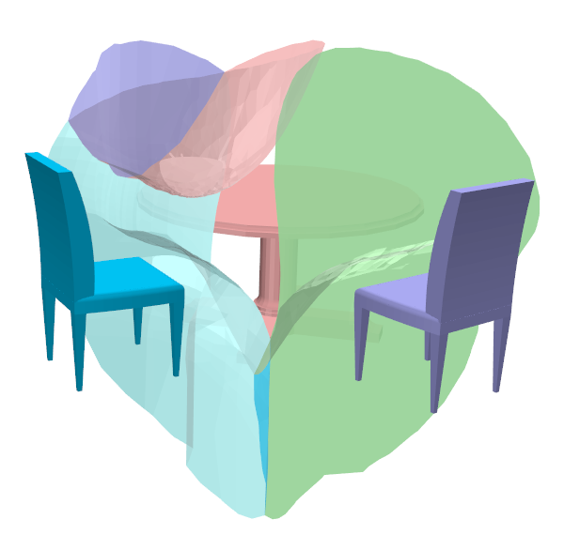
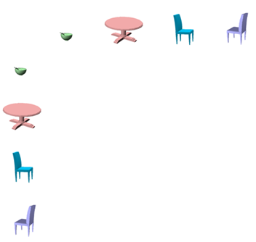
Building Scene Structure
Compute closeness matrix based on IBS
Build scene structure by HAC method
 | -- | 0.77 | 0.02 | 0
 | 0.77 | -- | 0.61 | 0.61
 | 0.02 | 0.61 | -- | 0
 | 0 | 0.61 | 0 | --
Notes:
Hierarchical Agglomerative Clustering (HAC)
Here we propose a method to compute a hierarchical structure of scenes using the IBS.
First we define a closeness measure between different objects based on the geometric features of the IBS.
We can build a closeness matrix for the scene.
Then based on this matrix, we use the Hierarchical Agglomerative Clustering(HAC) method to merge scene elements
iteratively, until all the objects are merged to one big node.
Given one object in a scene, we can find neighbours of this object at different levels.
For example, the bowl in this scene has an immediate neighbour, “the table”, and two other farther away neighbours, “the two chairs”.
In the next experiment, we use this information to do the retrieval of single object based on its spatial relationship with its environment.
21

Slide 22
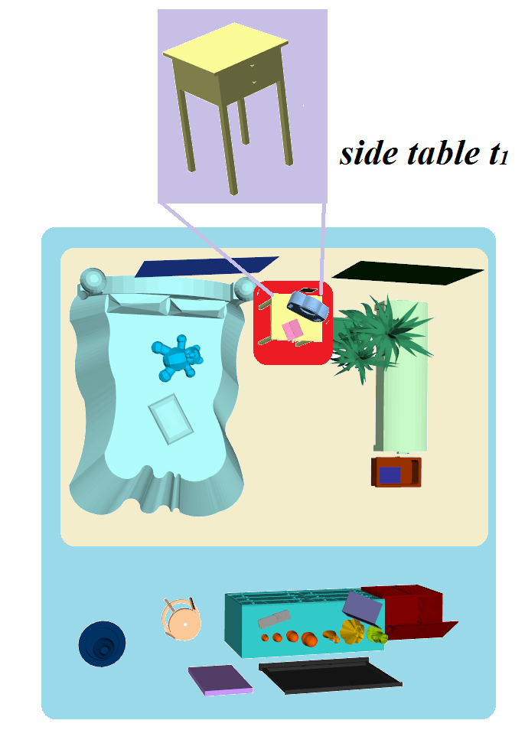
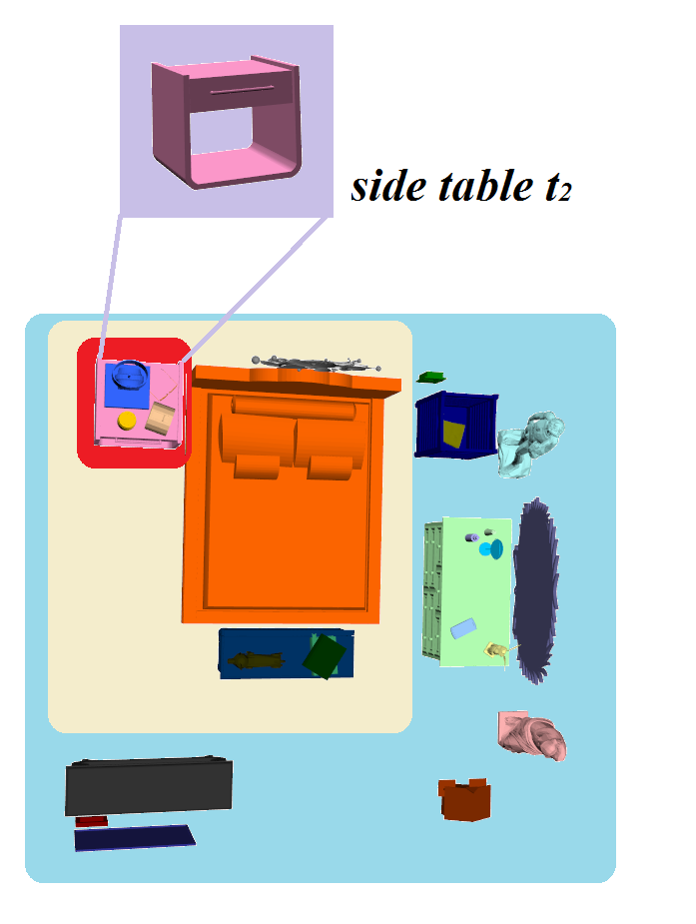
Retrieval of Object in the Scene
Level 1
Level 2
Level 3
Notes:
Here, we use both the IBS features and the scene structure to compare the status of objects in different scenes.
For example, say we want to compare the status of these two side tables in two different bedrooms.
We first consider the spatial relationship between the query object and its immediate neighbors, which are the objects within the red region.
Then we consider the farther away neighbors, which are those objects located within the yellow region.
This process can be further applied to objects further away.
By considering each level of neighbors, we can find how similar the status of these two objects are.
Next we will show some retrieval results.
22

Slide 23
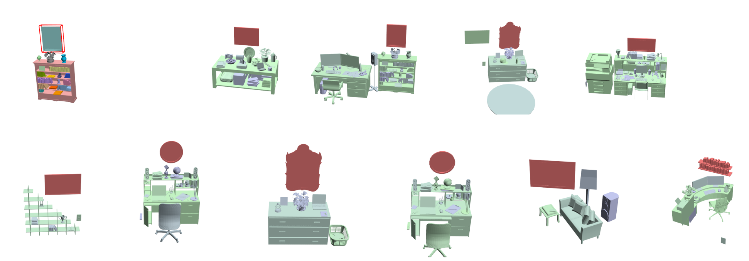
Retrieval of Object in the Scene
Query:
Results:
Notes:
Here the query is a picture which is hanged above the book shelf.
By using our system, we can find different picture/ mirror types of objects which hang above furniture in various scenes.
As our retrieval system is only based on the spatial relationship, the results are less influenced by the geometry of the objects.
23

Slide 24
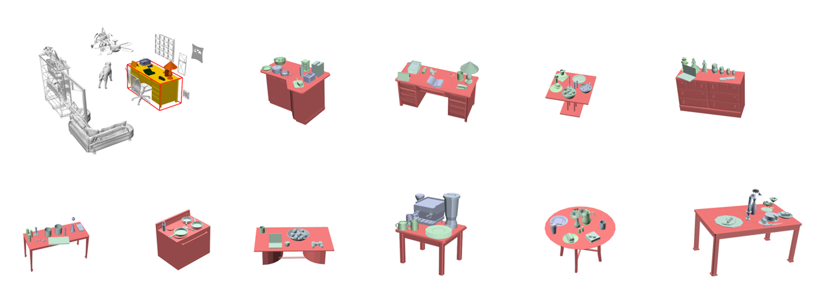
Retrieval of Object in the Scene
Query:
Results:
level = 1
Notes:
We can also specify the level numbers of neighbor we like to consider when doing the retrieval.
For example here, if we only consider the immediate neighbors of the table, we got these results which are different tables with objects on them.

Slide 25
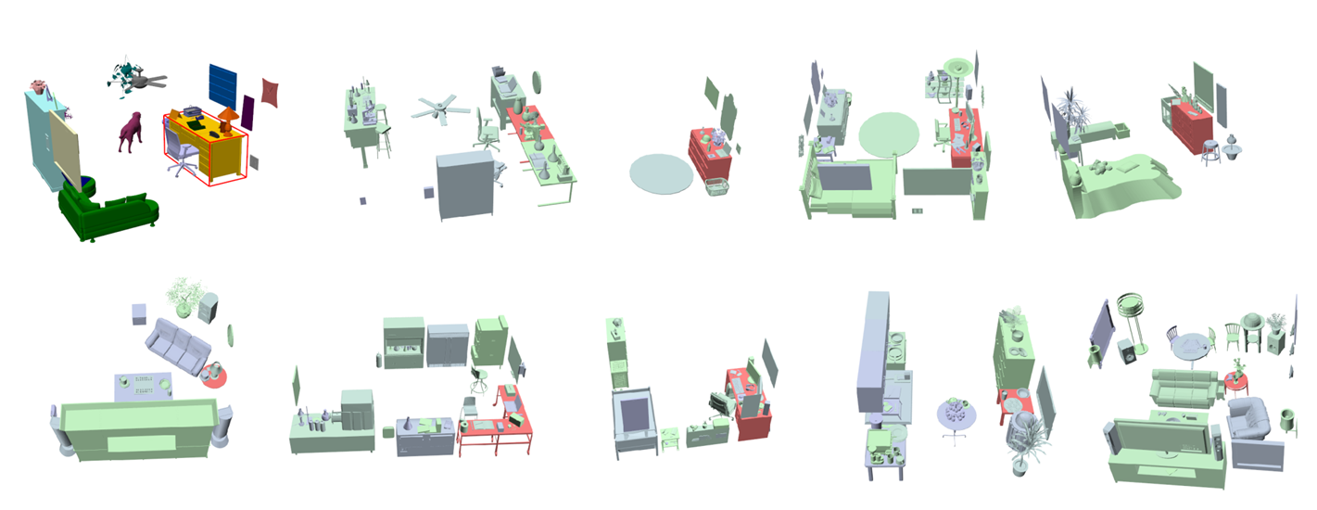
Retrieval of Object in the Scene
Query:
Results:
level = 3
Notes:
If we set the level to 3, objects further away are taken into account, and objects in a similar status with respect to further objects are retrieved.

Slide 26
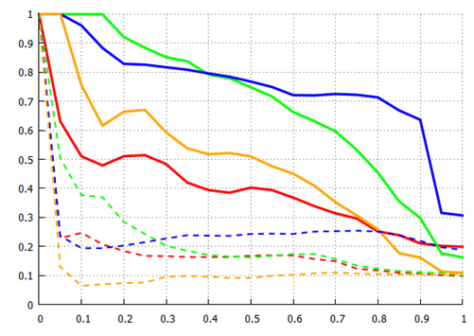
Evaluation of Retrieval Results
Our method
Precision
Previous method
Recall
Notes:
To evaluate our retrieval system, we conducted a user study.
We show the query and the retrieval results to the users and
let them vote if the status of the resulting objects are similar to that of the query object.
We only consider a resulting object is related only if half of the user think it is related.
The precision and recall curves are then computed based on label given by users.
The solid curves are the results by using our IBS-based method, while the dotted lines are those by previous simple representation of spatial relationships.
The solid curves have a large region below it compared to the dotted curves,
which means our ibs-based features produces more satisfactory results compared to the simple features used previously.

Slide 27
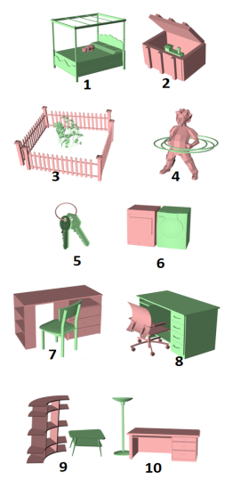
Conclusion
IBS is a rich representation of spatial relationships between objects in 3d scenes
Structure construction
Classification
Retrieval
Notes:
We proposed a representation of the spatial relationship between objects in 3d scenes that provides rich information.
With this new representation and its features, we can do classification, scene structure
construction. Based on the IBS features and the scene structure, we can also do retrieval of single
object in a large 3D scene in terms of its spatial relationship with respect to the surrounding objects.

Slide 28
Limitations and Future Work
Limitations
The computational cost is higher
Only focus on spatial relationship
Future work
Extra features (labels, object geometry)
Whole scene retrieval
Character-object interaction
Notes:
In the future, we like to improve our system in the following ways:
First, we like to combine our spatial relationship based features with other available information,
for example the shape feature of each object, the label of object, et al.
Second, we are also interested in applying our representation for the retrieval of object groups and retrieval of the whole scene.
Third, we like to apply our method to the analysis of character-object interaction motion. How to deal with such
temporal sequences data is also a future direction of our work.

Slide 29
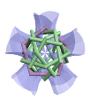
Acknowledgement
Anonymous reviewers
CGVU group
Shin Yoshizawa
Attendees of user study
China Scholarship Council
EPSRC Standard Grant
EU FP7/TOMSY

